Slide 1
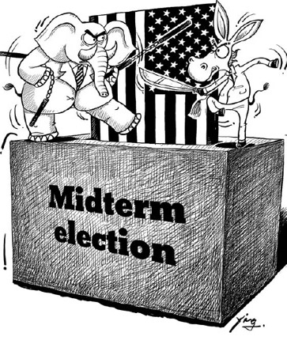
ANALYSIS OF THE U.S. MIDTERM ELECTIONS
1976-2016
Victoria Bateman, Kaushik Sharma and Jyotika Khullar
Notes:
1

Slide 2
Objective
Build a model to predict US Midterm elections successfully
Compare results from 3 different models – Multivariate Regression Analysis, Random Forest Classifier and Bernoulli Naïve Bayesian
Use Accuracy and Mean Squared Error as the differentiating criteria
Notes:
2

Slide 3
What’s in our dataset?
Accessed from MIT Election and Data Science Lab
Two different datasets – House and Senate
Returns for the years 1976-2016
The dataset has important information like:
state
party name
name of the candidate
the total votes received by the candidate
total votes that were cast for the election.
Notes:
3

Slide 4
Data Preparation
Remove Missing data
Generate new features
Remove extreme outliers
General Exploratory Data Analysis
Creation of Test and Train Models
Analysis of House Dataset – Stats modules
Analysis of Senate Dataset – Sklearn modules
Notes:
4

Slide 5
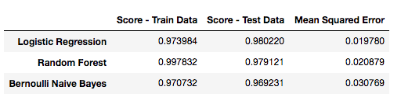
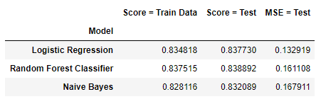
Analysis using Machine Learning Models
Our models performed similarly in terms of accuracy, with small changes in Mean Squared Error.
Notes:
5

Slide 6
Conclusion
As the results suggest, the three models used for analysis tend to streamline and produce effective results.
We can continue to improve the accuracy scores, as for the current analysis there were only 4 viable features.
Further study and consideration of macro and micro social and economic data, national and regional as well polling data and political market research will help improve the predictions.

Slide 7


